Slide 1
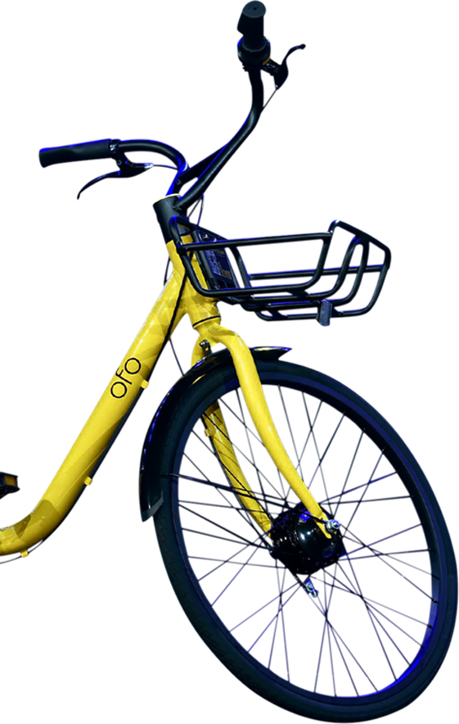

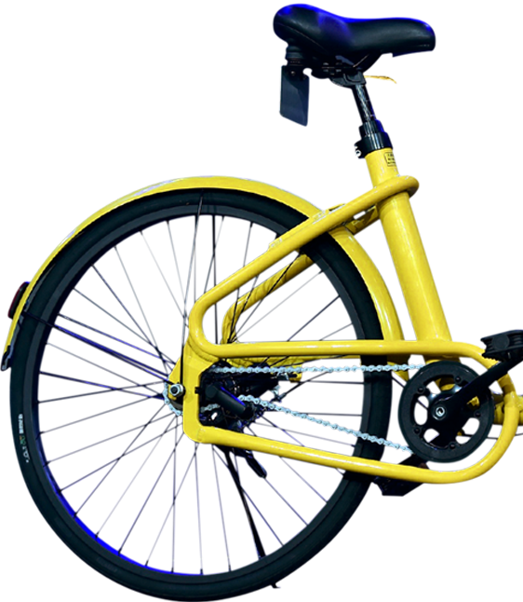
Team 6
Ride Anytime
Anywhere
Bike-Sharing Service
Yixin Luo, Dehui Geng, Yin Hang, Haowen Zhu, Weiqing Li

Slide 2
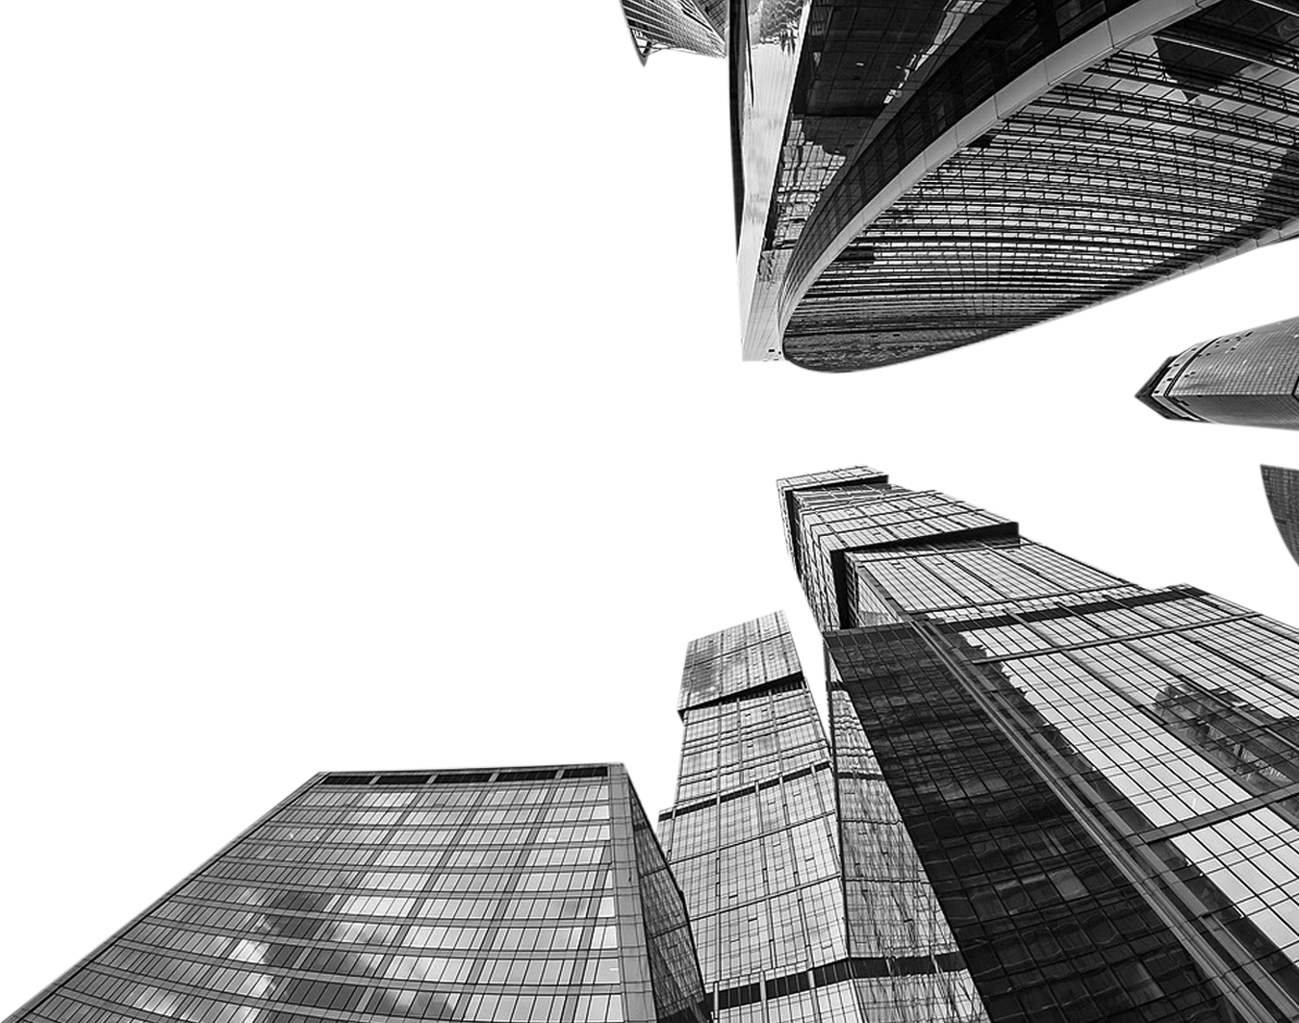
Bike-Sharing system, a newly raised business model spreading from Europe to all over the world, provides bike-renting service in the public areas of school, community and shopping zone in time-multiplexed leasing model.

Slide 3
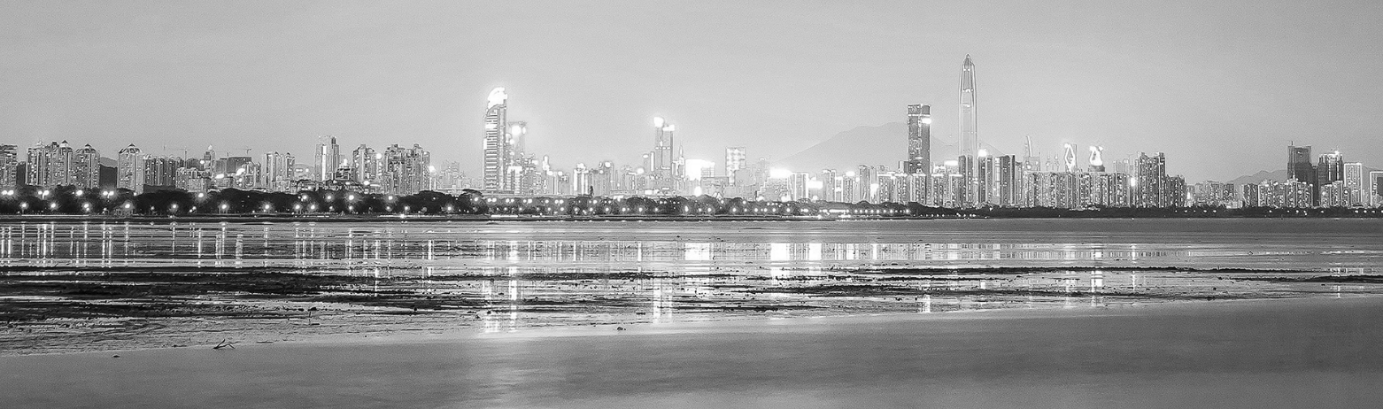
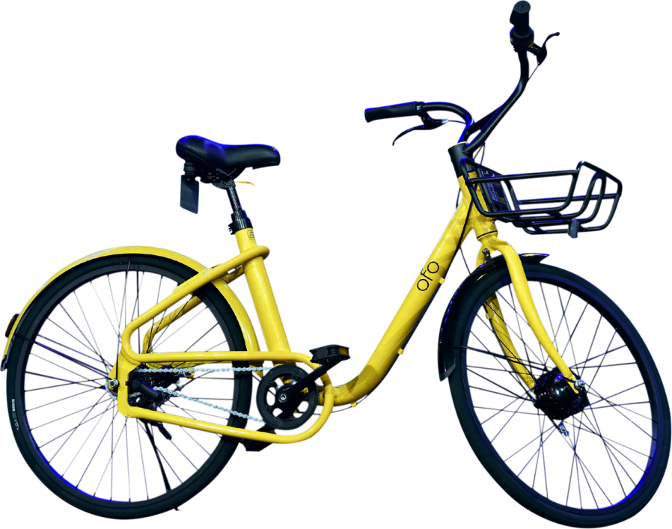
Ofo bike-sharing system has become phenomenal and could be easily seen in every corner in the China
Connect bikes
Connect the world

Slide 4
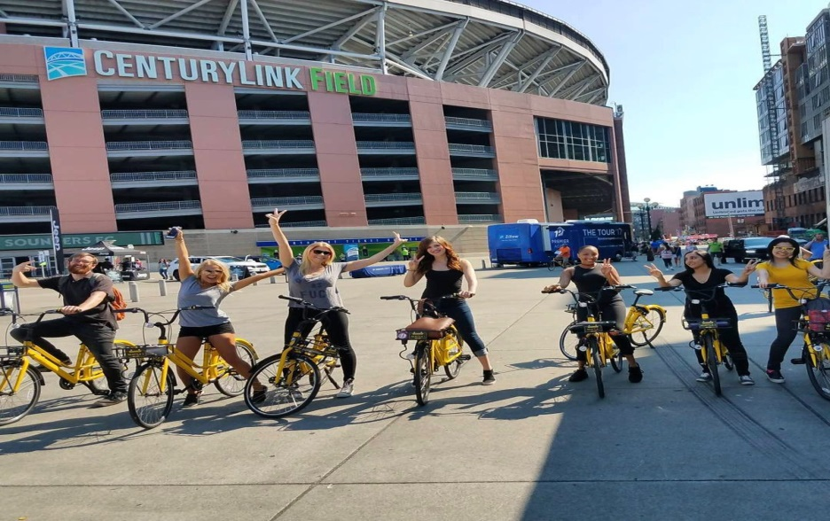
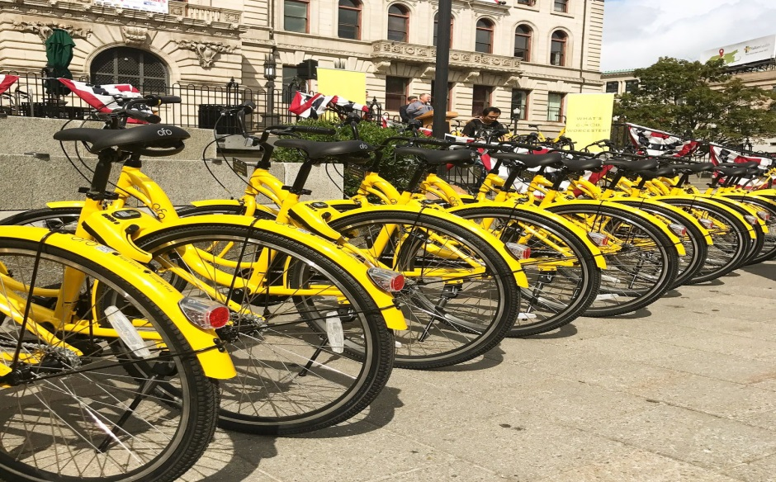
2017/ 08/ 17
Ofo lunched in Seattle, bringing one thousands yellow bikes into the city
2017/ 09/ 14
Worcester became the second U.S. city to receive the iconic sunny-yellow bikes

Slide 5
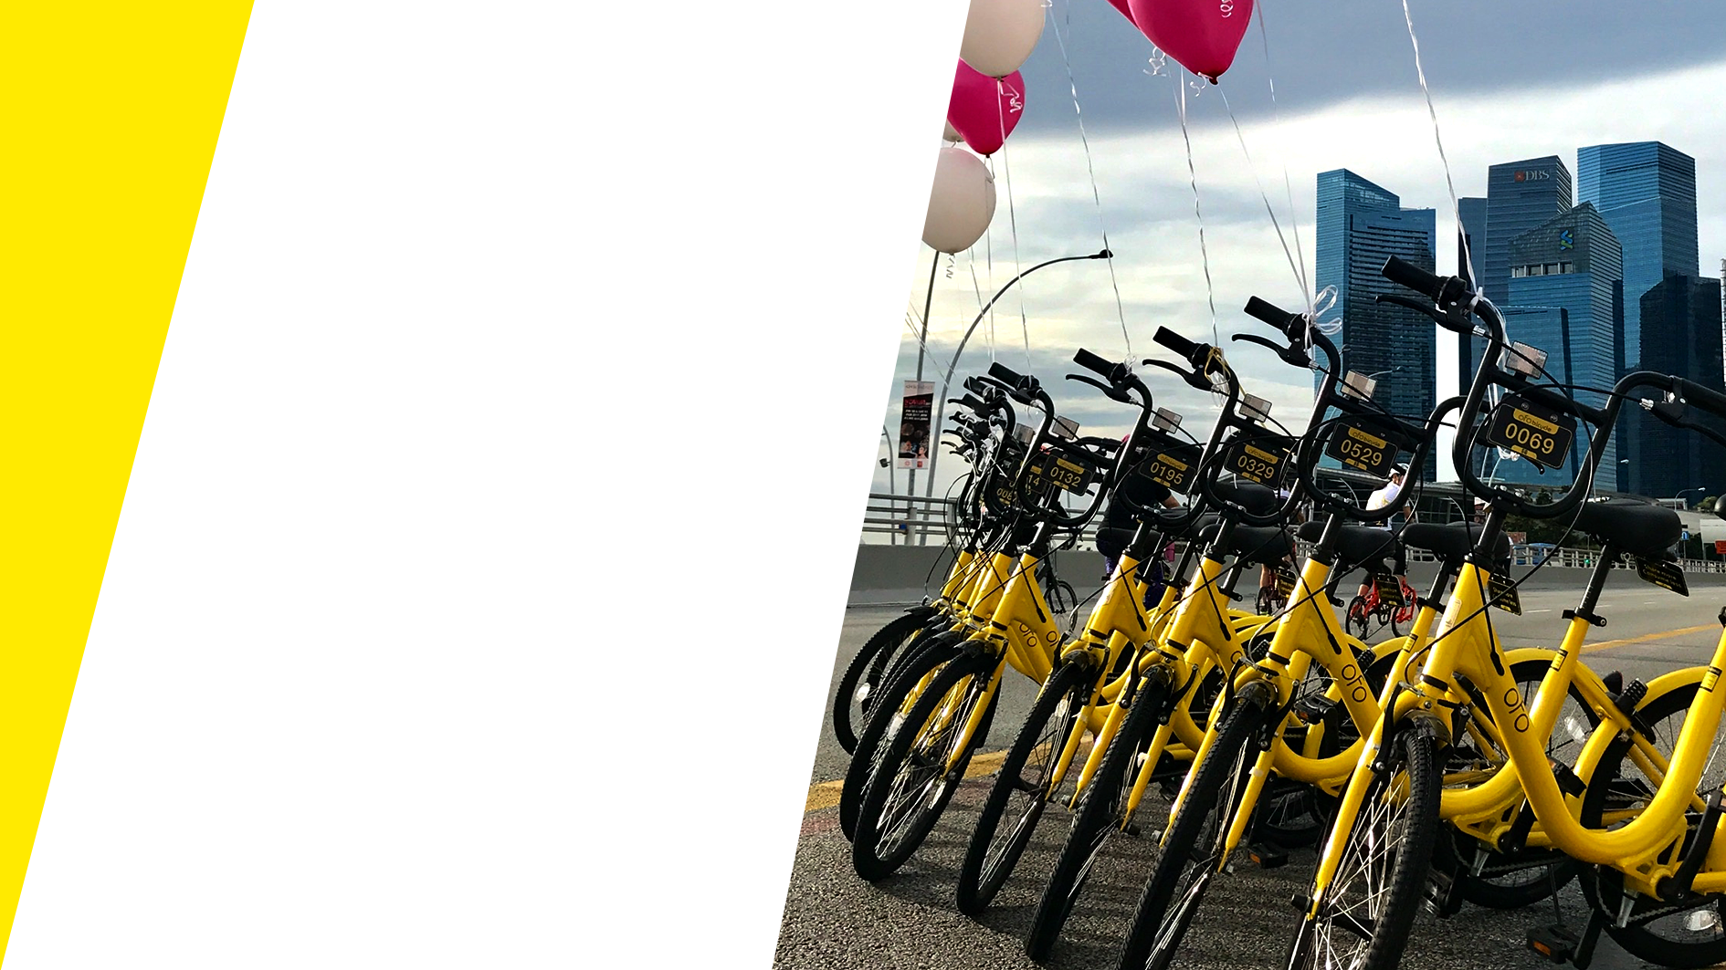
Who is the next?

Slide 6
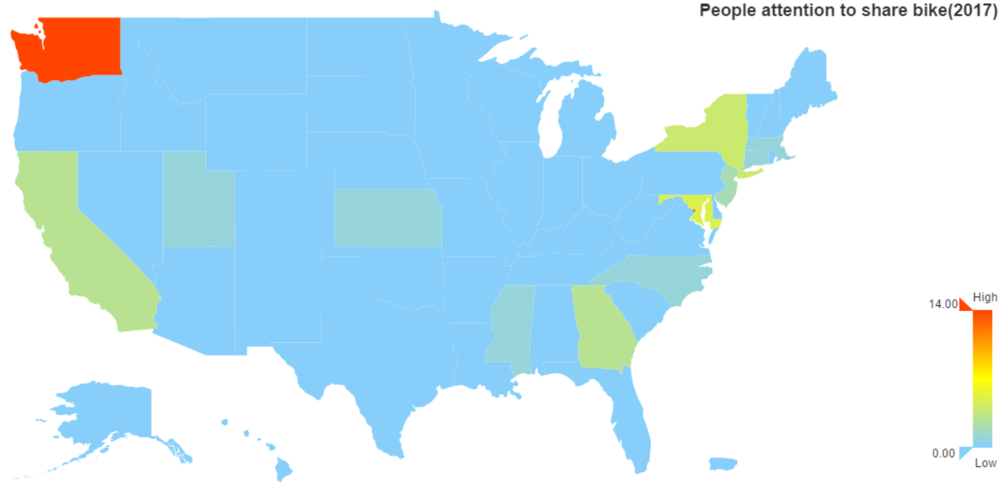

Slide 7
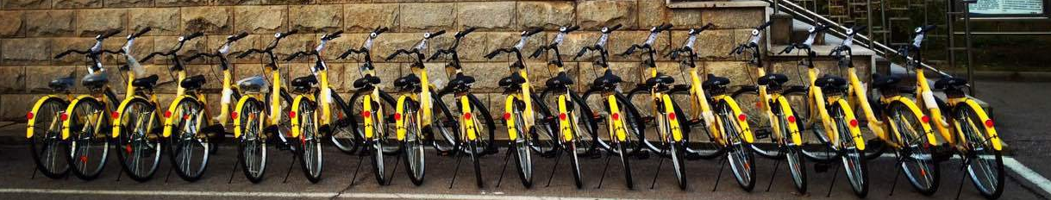
The next targeted city
01
The most popular area is Seattle with red color filled. This is in accordance with the real market: Seattle is the one of the cities that share bikes launched firstly.
02
A small red dot corresponds to the Washington city and the adjacent area has green color in the map. The bike-sharing business is still being spreading and might be introduced to this area.
√
√
03
√
For other cities, the concept of bike-sharing system is relatively new.
04
√
Eastern U.S might also be the potential place to be the next targeted market.

Slide 8
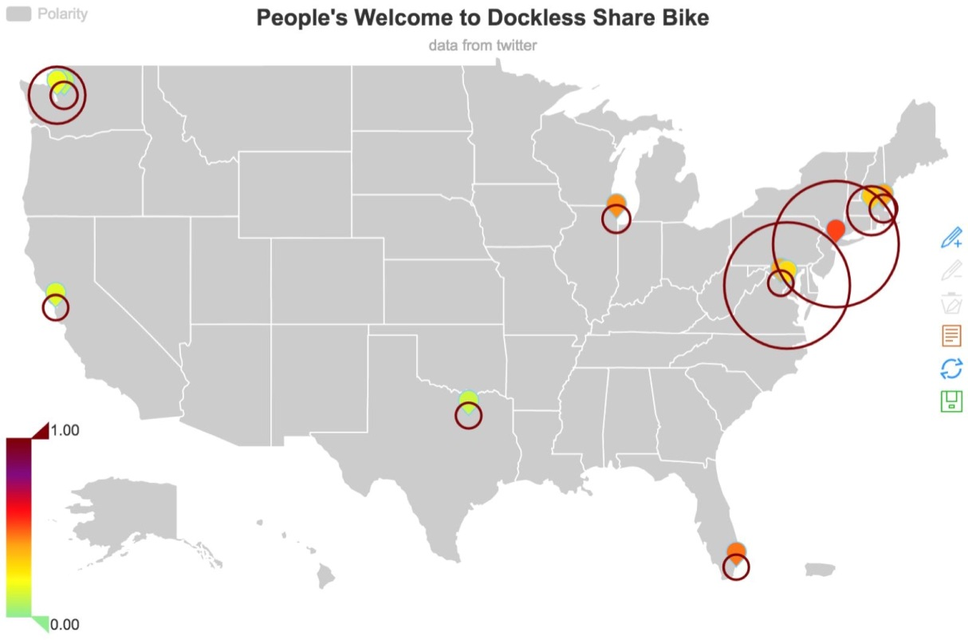

Slide 9
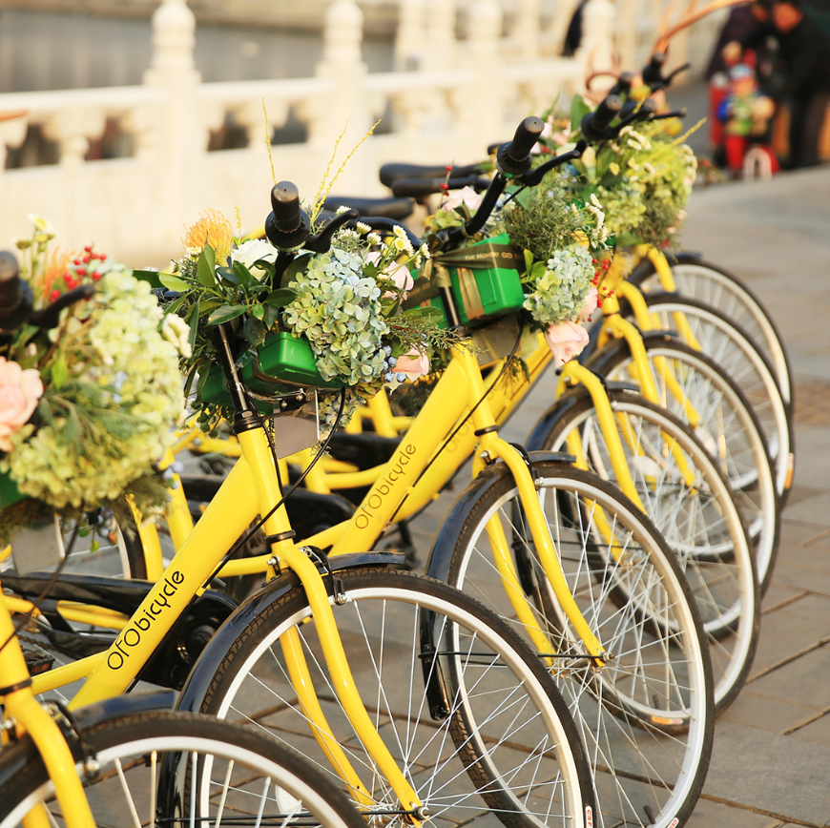
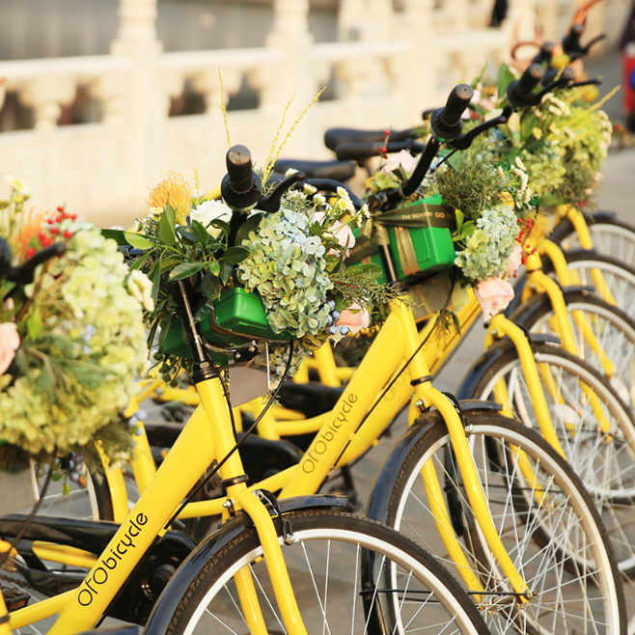
Current Development Analysis
01
The size of the circles refers to the popularity of certain bike-sharing brand
Some cities are overlapped by two circles, which indicates that two famous brand has put bicycles in this area
02
The color refers to the customer satisfaction to certain brand bike-sharing service. Color from light to dark means the satisfaction goes up.
03
Notes:
Take the Washington city as the example. It has two circles. The bigger one corresponds to ‘Mobile Washington’, the smaller one corresponds to ‘Capital Bike Washington’. Their sentiment scores are 0.2314 and 0.2142.

Slide 10
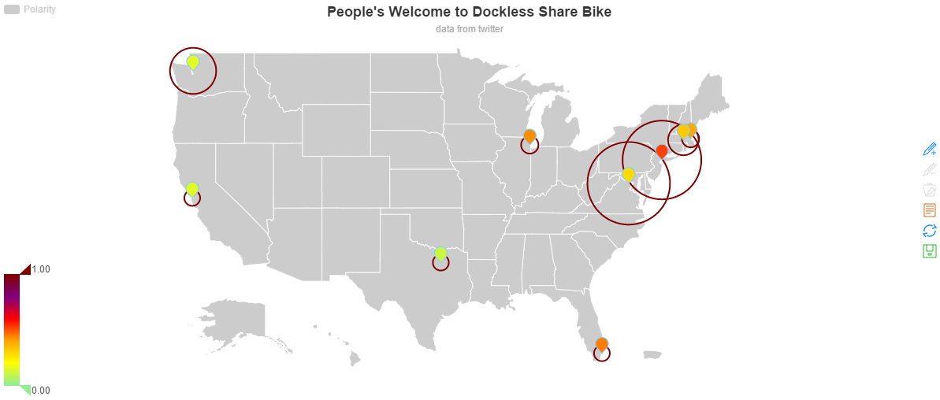

Slide 11

CLICK HERE TO ADD THE TITLE
We get the weight average of the tweets about different brand of bike share company and plot the precious figure again.
For this figure, the color represents the individuals’ support for the concept of bike share. The deeper color means the citizens support the bike share more.

Slide 12
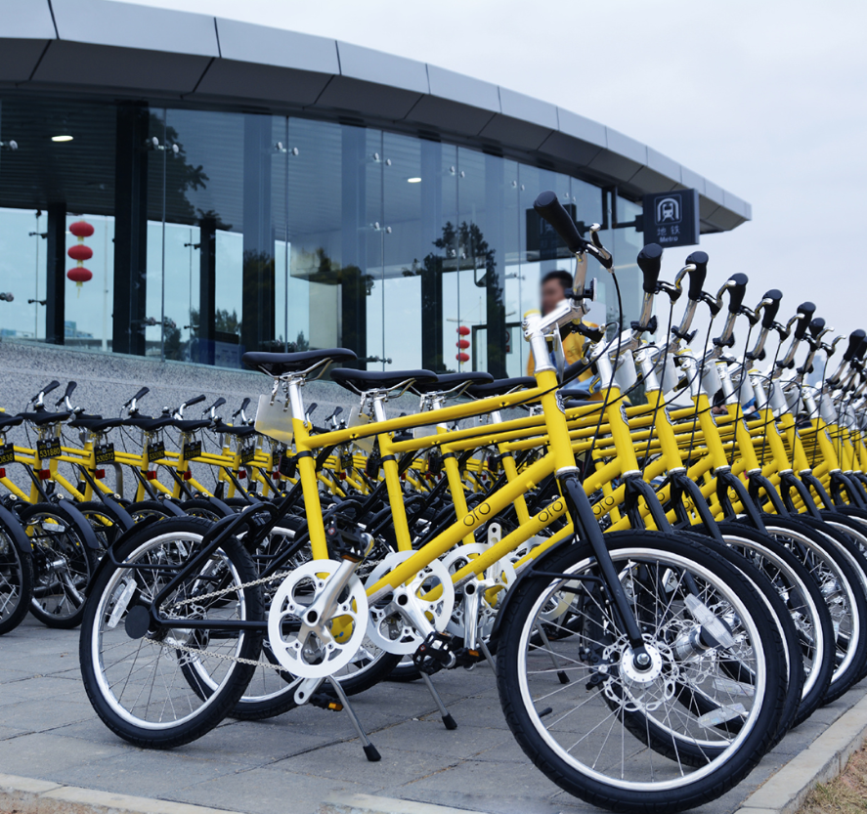
Conclusion
The business is still under evaluation by some cities. We want to predict the future development of bike-sharing service through this research and offer more strategic decisions for its implementation.

Slide 13
THANKS

